Slide 1
Finance Management System: A DBMS Approach for Efﬁcient Accounting and Finance

Slide 2

Introduction
Effective finance management is indispensable for individuals and organizations alike, serving as a strategic compass for achieving financial goals and maintaining stability. It involves prudent resource allocation, meticulous budgeting, and adept risk management, ensuring optimal cash flow and fostering sustainable growth. Finance management plays a pivotal role in debt management, investment decisions, compliance with regulations, and governance standards.
For individuals, it facilitates personal financial planning, while in a business context,
it contributes to sustainability by optimizing costs, managing working capital, and ensuring profitability. Beyond these immediate benefits, finance management empowers
decision-making through informed assessments and strategic choices.
Whether navigating personal milestones or steering organizational success, sound financial management practices are integral for resilience, long-term growth, and the realization of financial objectives

Slide 3

Problem Statement
Finance management poses significant challenges for enterprises, irrespective of their size, leading to operational inefficiencies, suboptimal decision-making, and potential financial risks. Manual processes, including data entry and asset-liability tracking, hinder operational agility and contribute to errors. Limited real-time insights into financial metrics impede timely decision-making. Poor cash flow management, budgetary constraints, and compliance risks further exacerbate financial difficulties. Integration issues with diverse systems, difficulty accessing financial services, and inadequate financial literacy compound these challenges. Additionally, enterprises struggle to adapt to emerging financial technologies. Recognizing these multifaceted issues, the project aims to develop a Finance Management System that addresses the intricate financial management needs of both small and large enterprises, offering scalable solutions.

Slide 4
ABSTRACT
This project aims to revolutionize financial management for startups by integrating a robust Database Management System (DBMS) with technologies like MySQL. The project streamlines financial processes, ensuring accuracy and efficiency in computations. It also automatically balances the balance sheet, providing a comprehensive overview of assets and liabilities. The integration of cutting-edge technologies, particularly MySQL, enhances computational power and adaptability to startups' evolving needs, empowering them with a user-friendly, efficient, and intelligent platform for managing finances.

Slide 5
Software Requirements and Specifications
1. Functional Requirements
1.1 User Classes and Characteristics
Define the different user roles and their characteristics (e.g., admin, regular user).
1.2 User Requirements
Detail the specific actions and capabilities of each user type.

Slide 6
Software Requirements and Specifications
2. Non-functional Requirements
2.1 Performance Requirements
Specify the expected response times, throughput, and resource utilization.
2.2 Security Requirements
Outline measures to ensure data security, access control, and compliance with privacy regulations.
2.3 Reliability and Availability
Define the system's expected reliability and availability metrics.
2.4 Scalability
Detail how the system will handle an increase in users, data, or transactions.

Slide 7
Implementation
Python: Used as the primary programming language for system logic and backend development.
MySQL: Employed as the relational database management system for data storage.
Tkinter: Chosen for developing the user interface due to its simplicity and integration with Python.

Slide 8
Implementation
Database Connectivity:
Python's MySQL Connector was used to establish a connection between the application and the MySQL database. SQL queries were implemented to retrieve, insert, update, and delete data based on user actions.
Business Logic:
Python functions were developed to implement the core business logic of the Finance Management System. This includes algorithms for budget calculations, expense categorization, and financial reporting.

Slide 9
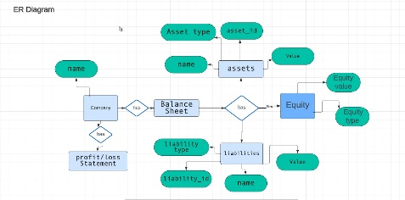
ER- Diagram

Slide 10
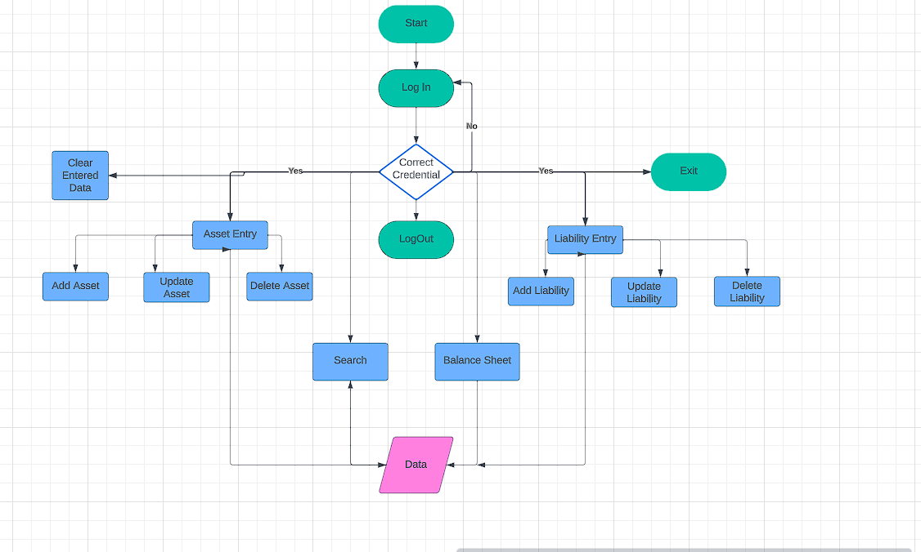
System Diagram

Slide 11
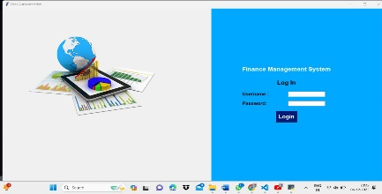
Screenshots

Slide 12
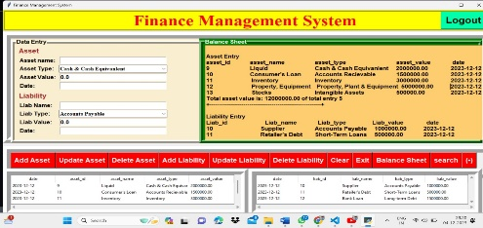
Dashboard

Slide 13
Benefits
1. Accurate Financial Tracking:
- Enables precise monitoring of income, expenses, and overall financial transactions, providing a real-time snapshot of financial health.
2. Budget Optimization:
- Facilitates the creation and management of budgets, allowing users to allocate resources effectively and make informed spending decisions.
3. Expense Analysis:
- Offers detailed insights into spending patterns, allowing users to analyze and categorize expenses for better financial decision-making.
4. Improved Decision-Making:
- Empowers users with actionable insights and data-driven decision-making capabilities, enhancing overall financial management strategies

Slide 14
Conclusion
In summary, a proficient finance management system is indispensable for organizations, offering streamlined budgeting, precise expense tracking, and insightful financial analysis. It not only enhances operational efficiency but also facilitates informed decision-making. This strategic tool contributes significantly to financial optimization, risk mitigation, and overall organizational success, making it a vital investment for sustained financial health..

Slide 15
Thanks!
Do you have any questions?

